Slide 1


Parking lot management application
Junior Java Developer Take-Home Assessment
Presented by Iquoc Tran

Slide 2

Project overview
Why Option 1?
To-Do List Application done in the past
Inheritance? Encapsulation? Injection? Separation of Concerns?
Overall Goal
Command-line parking lot management system
Supports parking, removing, and viewing vehicle status
Handles slot size validation
Built using object-oriented design principles

Slide 3
Design & Architecture
CLI interaction
Handling state versus business logic
Enumerator and ranking

Slide 4
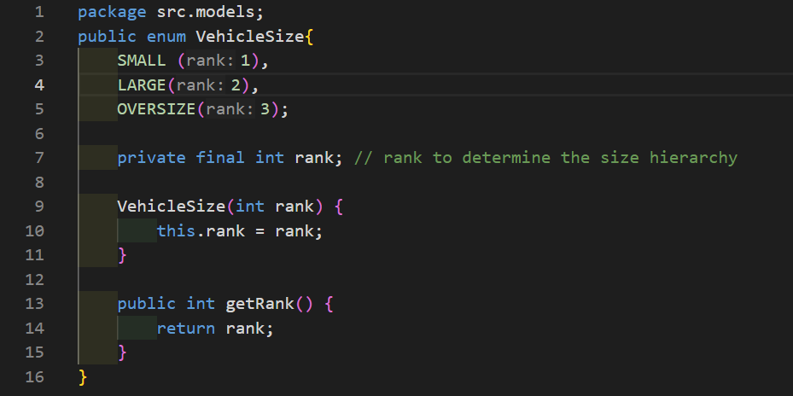
Key Design Decisions
Used enums for vehicle and slot sizes
Used service layer to separate business logic
Used constructor injection for cleaner architecture and improved testing
Derived vehicle status via data structures
Used validation rules for slot compatibility

Slide 5
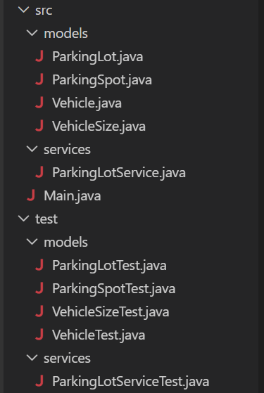

Key files & folder structure
src
Defines behavior
test
Validate behavior
model
Store state
service
Contains business logic

Slide 6
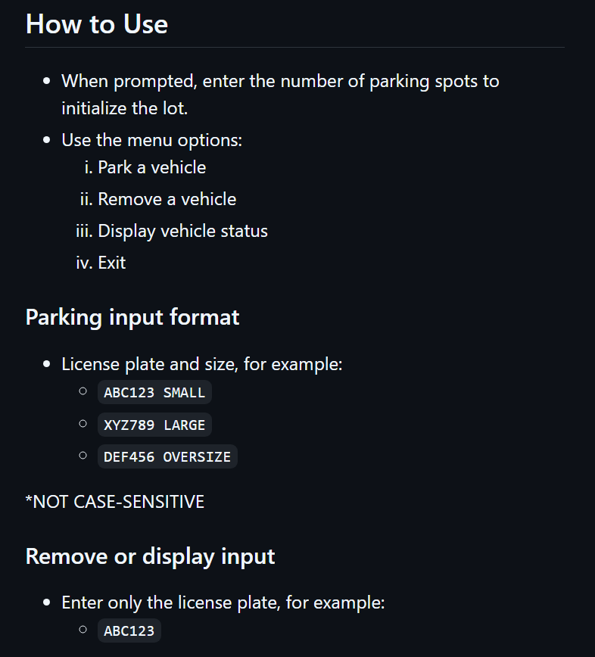
Running the application
Summary of README file found on the Git Repository
Requirements
JAVA SE Development Kit (JDK) 17 or later installed
javac and java available on your system path
Build
mkdir out
Compile
javac -d out src\Main.java src\models\*.java src\services\*.java
Run
java -cp out src.Main
Seed Data
For testing with initialized and preloaded vehicles parked, see lines 23-44 under Main.java

Slide 7
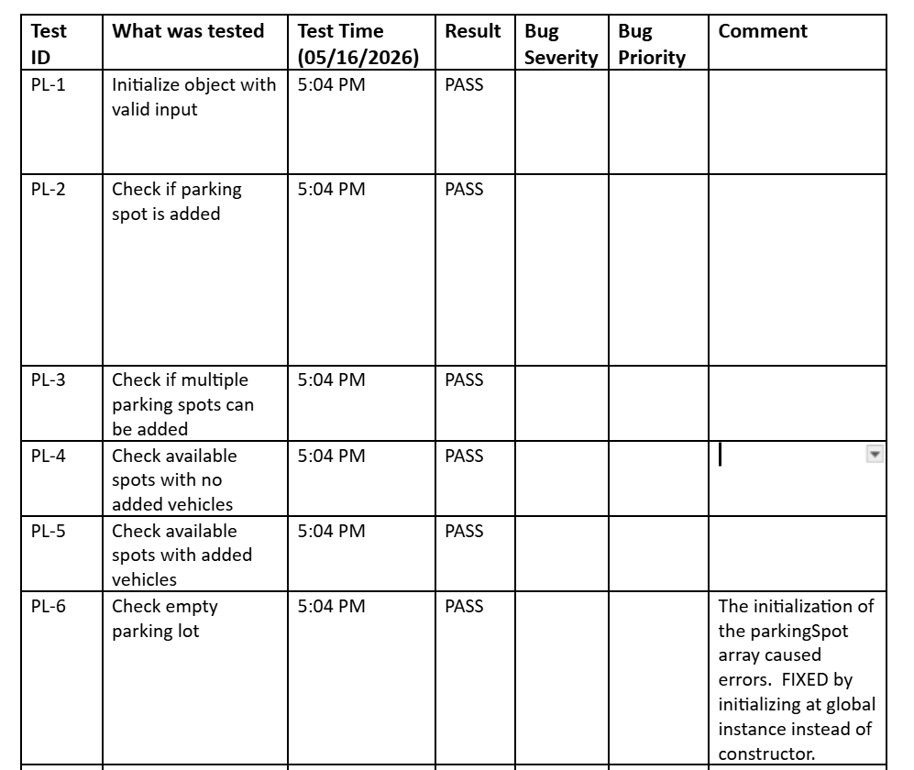
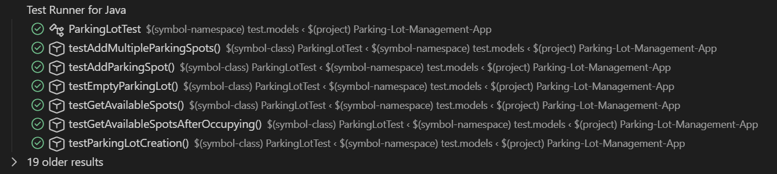
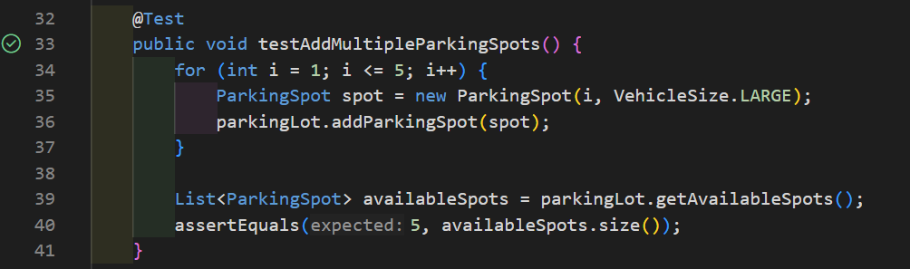
Testing & Verification

Slide 8
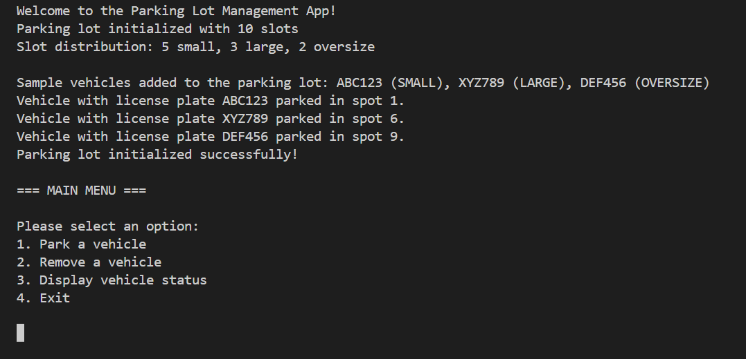
Seed data
Distributed 50:30:20
Sample vehicle
{ Xyz789 LARGE }

Slide 9
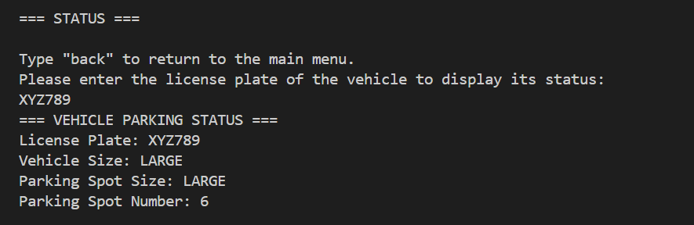
Demo 1
Input 1 -> 3
Input 2 -> XYZ789

Slide 10
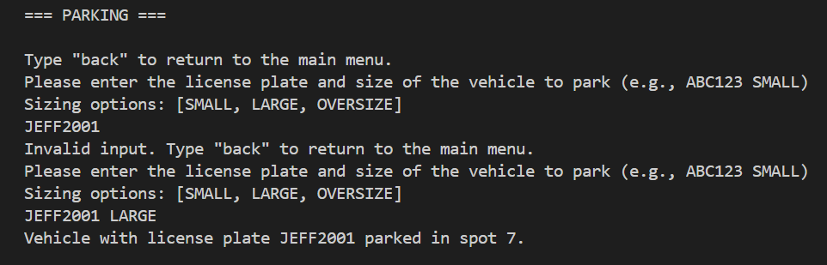
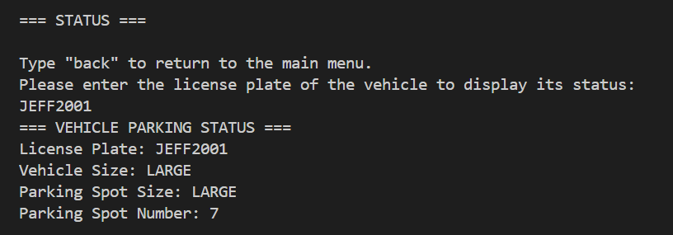
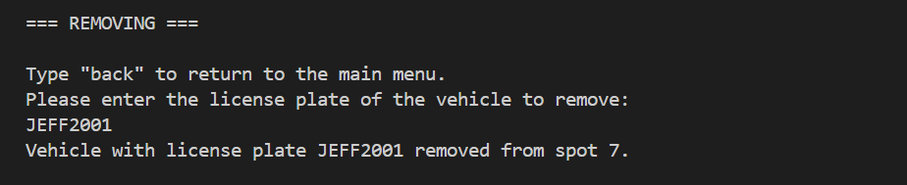
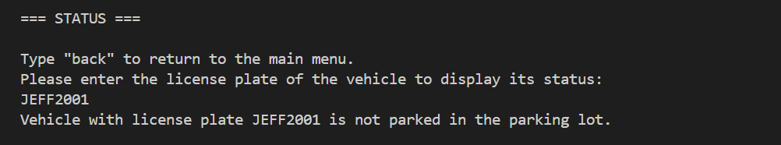
Demo 2
Parking -> {JEFF2001 LARGE}
Status -> Large spot #7
Removing -> from spot #7
Status -> Not parked

Slide 11
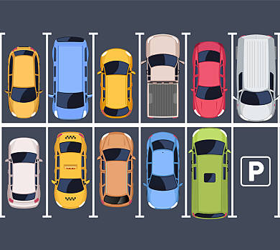
Future improvements
REST API with Spring Boot
Persistent database storage
GUI/Web Interface
No best-fit spot assignment
SMALL vehicles consume LARGE spots
Allocating Parking Sizes
Random
Evenly-distributed
Manual-distribution
Abstraction of Vehicles/Car
Sedan: Small
SUV: Large
Truck: Oversize
Expand Display Options
Taken parking spots versus open parking spots
2D Grid

Slide 12
Thank you!
Any questions?

